Slide 1
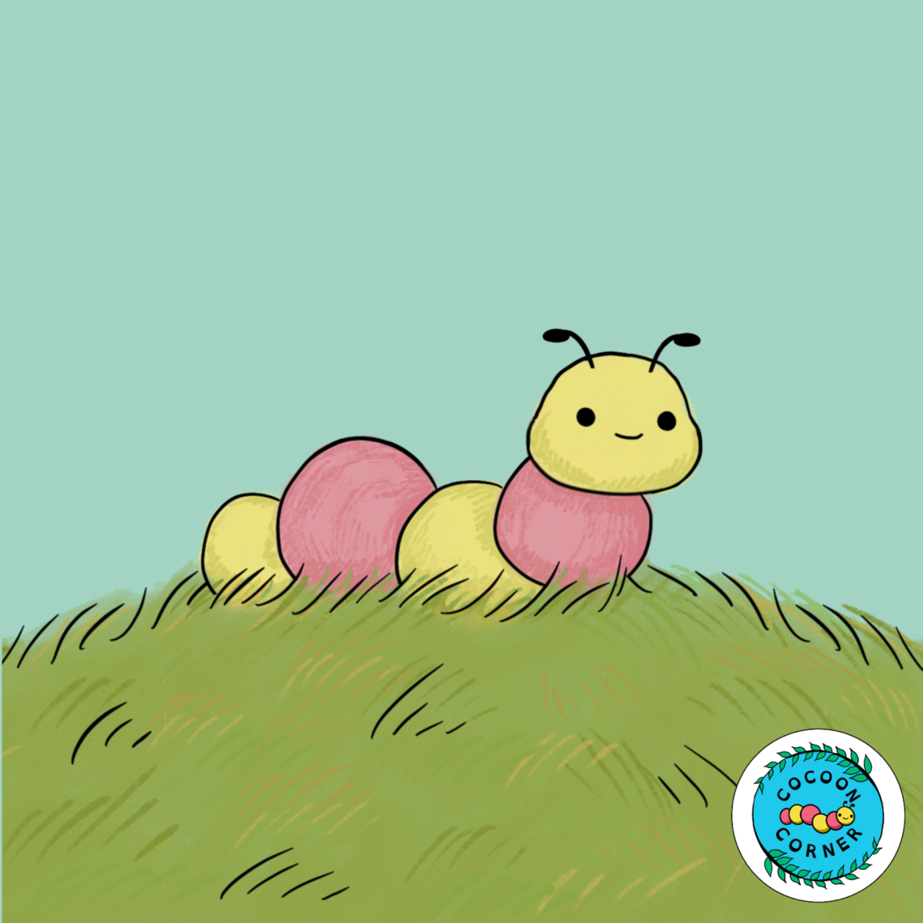


Cocoon Corner
STANFORD NEURODIVERSITY PROJECT
SNS
15 SEPTEMBER, 2025
Gautham Ramkumar
Haeley Kwok
Tallulah Turner
Camila Gonzalez
Joseph Tian
Manvi Sharma
Oriana Deng
Jaskaran Ahluwalia
Illustrations by Cami
Notes:
Haeley

Slide 2
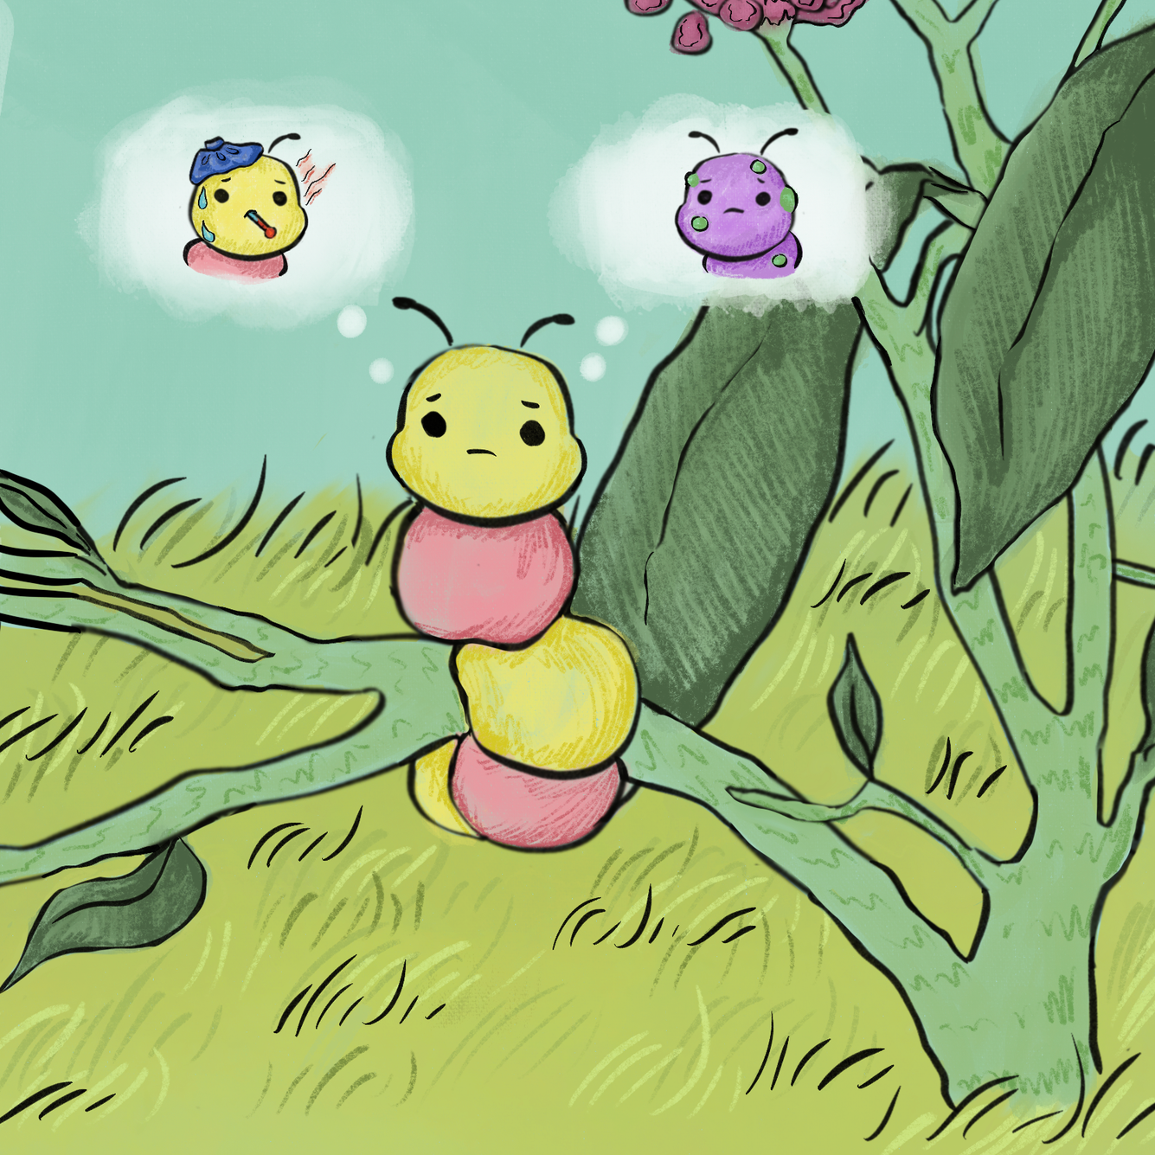
PROBLEM
  Recently diagnosed neurodivergent children struggle to understand their conditions
  Confusion and social challenges
Notes:
Haeley
less words (not reading from screen)
Recently diagnosed neurodivergent children struggle to understand their own conditions, leaving them vulnerable to bullying and exclusion, especially since their neurotypical peers are not educated about neurodiversity.
As a result, many children face inner confusion and social challenges, making it harder to build confidence, self-acceptance, and friendships.

Slide 3
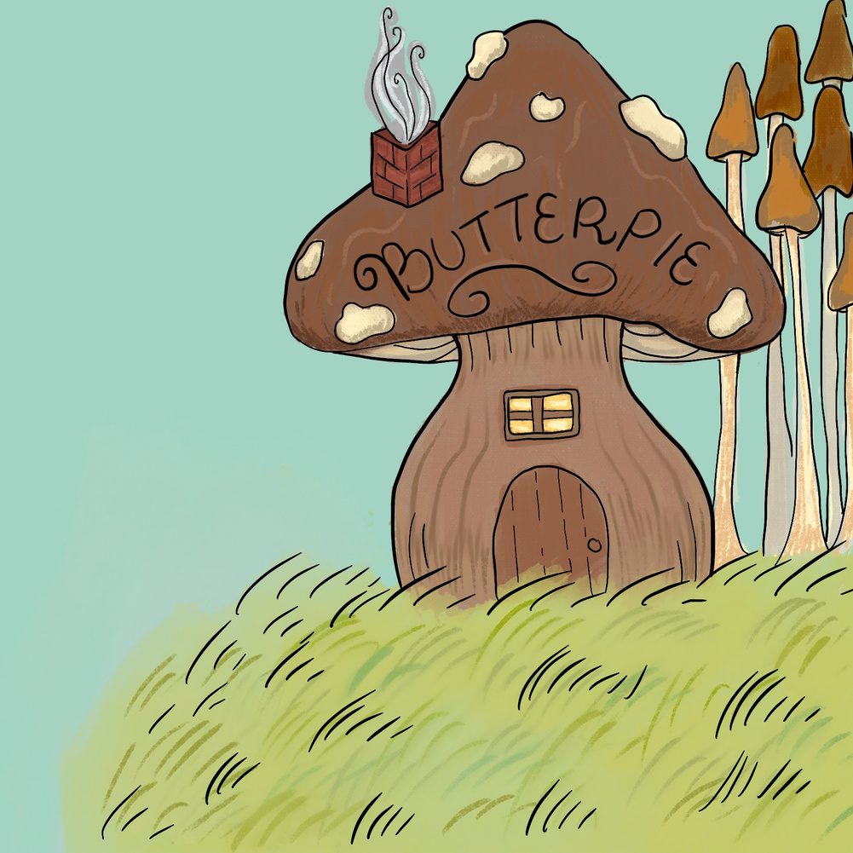


OUR MISSION
Cocoon Corner works to educate and validate neurodiversity for children. We have a two-pronged approach:
Storybooks
Sensory Spaces
Notes:
Haeley
- we hold a vision, a vision of a future in which neurodivergent people are understood and accepted. And the path to this societal understanding is education. if we can assert neurodiversity as a real and valuable human quality early in kids' lives, they'll carry this understanding with them into adulthood. with today's youth as the future, we’re building a neurodiverse-aware world starting with them.
- but how do we do this? As our mission states, we have two main methods, our storybook read-alouds and our sensory spaces. ideally, the institutions that we reach out to would be open to implementing both, but if one isn't feasible for a given venue, they could also work separately.
Our storybooks create a solid base of knowledge for kids about neurodiversity, and then our sensory spaces, or “cocoon corners,” create a tangible center for neurodiversity so this new concept stays relevant in their lives. You’ll shortly get to hear more about both.
- our unique approach establishes neurodiversity as a concept in kids' lives, cultivating an inclusive world for all brains. Now i’ll be passing it on to haeley who will be discussing our target audience.
(one minute from 2)

Slide 4
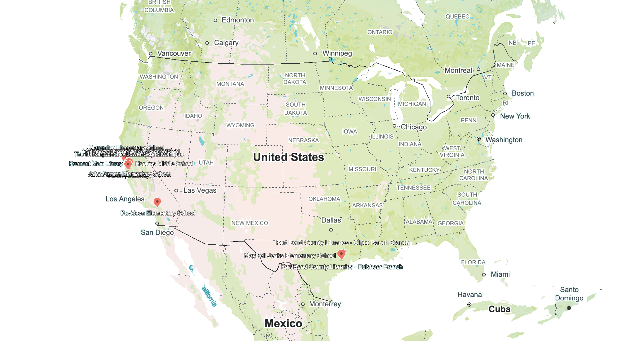
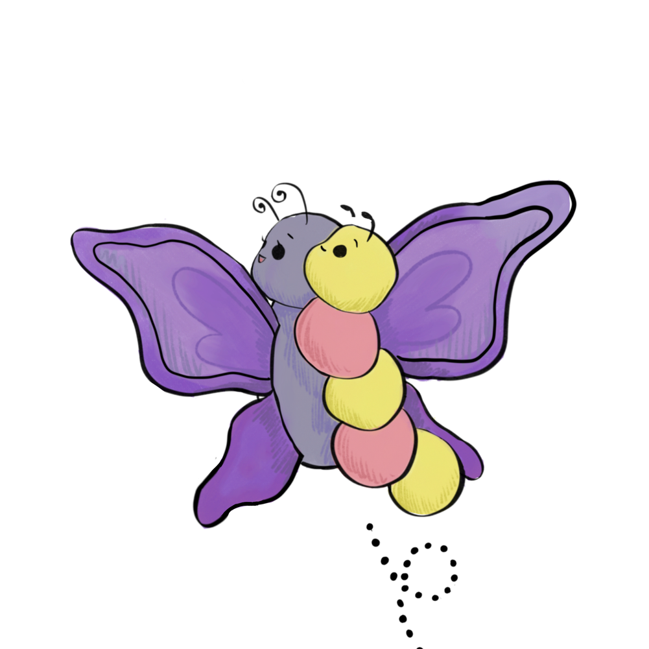
TARGET AUDIENCE
Recently diagnosed neurodivergent children (ages 5–12) living in the Bay Area, California, and Houston, Texas
Notes:
Haeley
all the places we've reached out to!!

Slide 5
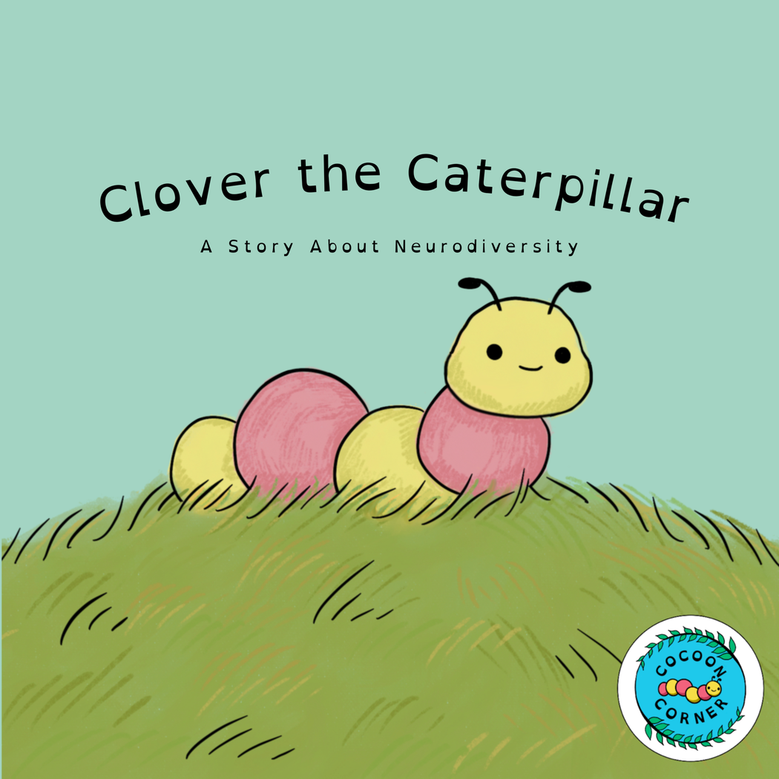
OUR BOOKS
  Pilot book: Clover the Caterpillar
  Newly diagnosed caterpillar finding her wings as a neurodivergent butterfly (fears)
  Provides definition of neurodiversity
  Common diagnoses
  Designed for read-alouds or individual reading
  Normalizes, introduces in engaging way
Art by Camila Gonzalez
Notes:
tallulah
We are proud to introduce our first book, clover the caterpillar. At the beginning of this picture book, we meet clover as a newly-diagnosed, confused, and unsure caterpillar, but by the end she has blossomed into her new identity as a neurodivergent butterfly. we get to come along for the ride as she discovers this amazing new community of neurodivergent butterflies. this book gives kids a solid definition of neurodiversity to build upon, assuming that this is probably their first encounter with the concept of neurodiversity. in our story, Clover's butterfly mentor, Miss Bloom, takes Clover around to visit different neurodivergent butterflies. These butterflies all explain their different conditions, conditions that we intentionally selected as the most common diagnoses that kids might encounter.
Clover the Caterpillar is used for read-alouds in our program, but also lives in our sensory spaces for kids to explore on their own. Next, you’ll get to hear from Cami about our progress.

Slide 6
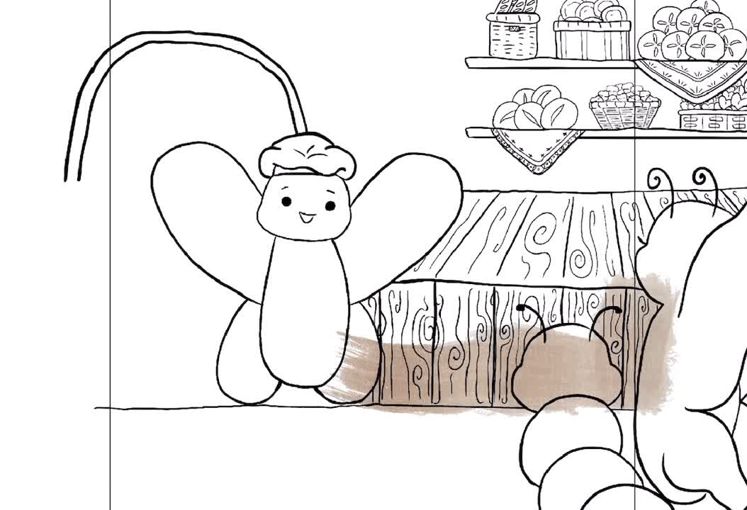
One sunny day, Clover the Caterpillar was at the doctor’s office. “We found out something special about you,” Dr. Moth told Clover. “You’re neurodivergent.” Neurodivergent?, Clover thought. What is that?. Do you know what being neurodivergent means? Clover had no idea. Dr. Moth checked her watch. “Do you have any questions before you go?” she asked. Clover had so many questions, but she was too scared to ask any of them, so she shook her head and left. Clover the Caterpillar left Dr. Moth’s office feeling scared and confused. Was neurodiversity a sickness, like a cold? Was she going to get purple and green bumps all over her? Was there something wrong with her? She sat down on a twig, full of worries. Just then, out of the sky fluttered Miss Bloom, Clover’s friend. “Are you okay, Clover?” Miss Bloom asked. “Not really, Miss Bloom. Dr. Moth just told me that I’m neurodivergent, and I don’t know what it means!” Clover explained. “Oh Clover, it’s okay!” Miss Bloom comforted her. “Let me explain. Just like how there are different hair colors and eye colors, there are different ways that brains work. If someone’s brain works different than most people, that means that they’re neurodivergent. Neurodivergent people usually have different strengths and challenges. Lots of people are neurodivergent!” “Do you feel better now that you know what being neurodivergent means?” Miss Bloom asked Clover. Clover shrugged. “Not really. I’m still a little bit confused.” “That’s okay.” Miss Bloom said. “Oh, I have an idea! Hop on my back, Clover, we’re going on a neurodiversity adventure!” Clover climbed onto Miss Bloom’s back and the two of them flew off. Clover and Miss Bloom landed at ButterPie Bakery. Clover’s tummy rumbled when she smelled the sweet desserts inside. Mrs. and Mr. Berry owned ButterPie Bakery together. All the butterflies in the forest came to their bakery to buy cookies, pies, cakes, and any other delicious treat you could think of. The store bell rang as Miss Bloom and Clover walked in. Mr. Berry popped out from behind the display case, his apron sprinkled with flour. “Hi, Clover! Good to see you. Can I help you two with anything?” Mr. Berry asked. “Hi, Mr. Berry!” Miss Bloom smiled. “Clover just found out that she’s neurodivergent. Isn’t that exciting?” Mr. Berry nodded. “Oh, yes! In fact, I’m neurodivergent too. I have a type of neurodiversity called autism.” “Every autistic person is different, and their autism shows up differently. My autism affects the way I experience the world. Sometimes, other butterflies don’t understand what I’m trying to say, and sometimes it’s hard for me to see what the other butterflies are feeling. I care about the people around me just as much as anyone else, but I show my love differently, like by baking for them!”, Mr. Berry explained to Clover. “Lots of autistic people have special talents. Mine is baking sweet treats, and I can talk about baking for hours. I’ve loved it since I was a little caterpillar like you. My parents saw how excited I was about baking, and they encouraged me to become a baker. One of the most important ways you can help an autistic person feel loved is by believing in them like my parents did for me.” “Wow. That’s great!”, Clover exclaimed. Neurodiversity was starting to sound pretty cool. Mrs. Berry walked in at that moment, carrying a basket of fresh blueberries for baking muffins. “Mrs. Berry, Clover is neurodivergent!”, Mr. Berry told her excitedly. “Oh, how great!” Mrs. Berry exclaimed. “You know, I’m neurodivergent too. I have a type called ADHD!” Miss Berry told Clover as she set down her basket. Clover had never heard of ADHD before. “What’s that?”, she asked. “ADHD means a couple things. I have great attention, I just have trouble controlling where it goes. When I’m doing something I love, like baking, I can spend hours working on it without any breaks. But when I’m doing something that I find boring, like washing the dishes, I have to take breaks or play music, or else I’ll get distracted. I have a lot of energy, so I like flying around much more than sitting still in one place. I forget a lot of things, like names, and I’ve lost my glasses seven times today!” Mrs. Berry laughed. “Mr. Berry helps me by reminding me of important things I need to do. But he hasn’t always been there to help me. When I was your age, I had some trouble in school. I’m very smart, but sometimes I have to work really hard to get work done that other people might think is easy. I would forget to do my homework and not be able to focus or sit still in class. Luckily, my teachers helped me by giving me more time to do the homework, a special quiet corner to take tests, and little toys to play with while I listened in class. After that, I loved school!” Mrs. Berry explained. “Yay!” Clover shouted. At that moment, Mrs. and Mr. Berry’s daughter ran in, wearing a pair of bright pink sunglasses. Baby Berry was in Clover’s class at school, but Clover had never thought to ask Baby Berry why she always wore the same pair of shades. “Baby Berry, why are you wearing sunglasses?”, Clover asked. “I have both autism and ADHD, or AuDHD! Because I’m autistic, light is extra bright for me. I wear sunglasses so I don’t feel overwhelmed,” Baby Berry replied. “Wow,” Clover said. “I didn’t know you could have more than one type of neurodiversity.” Baby Berry smiled. “Actually, neurodivergent people usually have more than one kind of neurodiversity. And it’s super interesting to see how different types blend together! Some days, I like to have a regular routine with my autistic dad, who does the same thing every day. But some days, I need a new adventure with my mom, who does new things all the time with her ADHD. I’m really lucky to have neurodivergent parents, because they know exactly how to support me. I also have a lot of neurodiverse friends at school! We have a neurodiversity club… you should join us!” Clover grinned and jumped up and down. “That sounds so fun!” Mrs. Berry began to pack a brown paper bag with sweet baked goods. “If Mr. Berry and I weren’t neurodiverse, our bakery would never have been this great.” Mrs. Berry told Clover. “My ADHD works perfectly with Mr. Berry’s autism. I’m great at some things, he’s great at other things, and together we get everything done. Mr. Berry likes doing the same things every day in the same way. He makes our most popular sweets every morning, so there’s enough for everyone who visits our bakery. I like a new adventure every day, so I invent new desserts and find ingredients in the forest! Together, we make a great team,” Mrs. Berry explained as she added a couple of chocolate-chip cookies to the bag. “My autism also gives me extra strong tasting skills,” Mr. Berry piped up. “I can taste every flavor, which makes me fantastic at testing new pastries.” Mrs. Berry slid an entire apple pie into the bag, and then handed it to Clover. “Thank you for coming to visit us, Clover. It’s always great to meet another neurodivergent butterfly!”, Mrs. Berry patted Clover on the head. “Thank you so much for the desserts!” Clover exclaimed. “And thanks for telling me about ADHD, autism, and AuDHD.” Miss Berry cleared her throat. “Well, we’d better keep on going with our adventure, but it was great seeing all of you!”. Clover and Miss Berry waved goodbye as they left the bakery. Clover the Caterpillar and Miss Bloom arrived at the colorful art studio in the tree trunk. Fantastic Flora, a beautiful blue butterfly was working on a painting of the sky. “Hi Fantastic Flora!” greeted Miss Bloom. “Your painting looks so pretty.” “Thank you Miss Bloom! Painting helps me have less intense tics.” replied Flora. Clover didn’t know what Flora meant by tic. “What’s a tic?” She wondered. “A tic is a sound or movement that I do repetitively and have trouble controlling. I have a type of neurodiversity called Tourettes, so… [explain it]” After hearing from Flora, Clover began to understand what neurodiversity means. “Thanks for explaining, that’s so cool that we are both neurodivergent!” “Anytime! Have a nice day!” Fantastic Flora waved goodbye to Clover and Miss Bloom with a smile on her face. Their next stop was the neighborhood library. Clover loved coming here to check out fun books to read. “Why did we come to the library?” Clover asked Miss Bloom. “Well, the lovely librarian Mrs. Willow is neurodivergent too. She has dyslexia.” “Thanks Miss Bloom, that’s right I was born dyslexic!” said Mrs. Willow. “Dyslexia, can you explain what that is?” “[explanation of the condition]” Wow, there are so many types of neurodiverse conditions. This is so cool! Clover thought to herself. She felt so happy knowing that her town had a neurodiverse community. Then, Mrs. Willow handed Clover a book. “Before you leave, I want to give you my favorite book! It is dyslexia friendly, so it has specific fonts and spacing that make it easier for dyslexic people to read.” “Thank you so much! Have a nice day Mrs. Willow!” exclaimed Clover. After a quick walk, they made it to the school band’s performance stage. One boy was practicing the drums, playing beats for all of town to enjoy. Clover was friends from school with him. “Hi Elio! How are you?” asked Clover. She was really excited to see her friend. “I’m doing good! What brings you here?” “Well, I was just diagnosed as neurodivergent and Miss Bloom has helped me meet people who also have it.” “Nice! I have OCD, which means [explanation]” explained Elio. “Does it affect you when you play the drums though?” Clover asked. “Good question! Actually, playing the drums really helps me focus.” Clover the Caterpillar was really impressed by “Now that you’ve met all my neurodiverse butterfly friends, I have one more surprise to show you,” Miss Bloom fluttered through the air. Clover was feeling much better by now, and flew in a loop-de-loop. “I love surprises! Can you give me a hint about what it is?” “Some of our neurodiverse friends have super-senses. Sounds are extra loud, textures are extra rough, and flavors and smells are extra strong. It takes a lot of energy to deal with all these senses, and sometimes it gets too hard. Neurodiverse friends might need to take sensory breaks, in special sensory spaces. Sensory spaces are quiet and comfy,” Miss Bloom explained. “Wow. Do you have to be neurodivergent to use sensory spaces?” Clover asked. “Not at all! Everyone needs breaks sometimes,” Miss Bloom told Clover. “Now that I’ve given you your hint, do you have any guesses where we’re going right now?” “Hmm,” wondered Clover. “Oh, I know! Are we going to a sensory space?” Miss Bloom smiled a knowing smile and said nothing. “We’re here!” Clover followed Miss Bloom as she landed in a patch of wildflowers. But it wasn’t just any flower patch. Flowers in every color of the rainbow reached up to the sky, creating shade and silence. Clover took a deep breath. The air smelled faintly of sweet nectar, and there was a soft breeze making the flowers gently sway. “Who made this?” Clover asked Miss Bloom. Right as Miss Bloom opened her mouth to answer, a small butterfly popped out from between the flower stems. He was carrying a watering can and a stack of cards with words on them. He held up a card: Hi, I’m Woody!, the card read. I’m autistic, and I’m non-speaking, so I use these cards to talk to people. “Wow, that’s so cool!” Clover exclaimed. I planted this garden as a sensory space for butterflies that need a break. I water the flowers and clean up the dead leaves. Do you like it? Woody flipped through cards. “Yes, I love it!” The garden made Clover feel relaxed and calm. I need to go plant some more seeds, but it was great meeting you! Woody waved goodbye. “Goodbye, Woody!” Miss Bloom said. “Thank you for introducing me to so many cool neurodiverse butterflies!” Clover thanked Miss Bloom. “Before, I didn’t even know what neurodiversity was, but now I love being neurodivergent. There are so many different types of neurodiversity– it’s so cool that all of our brains work differently!”, Clover exclaimed. Miss Bloom gave Clover a hug. “I’m so glad you think that. Sometimes, when neurodiverse folks don’t know how special their brains are, they feel sad that they’re not the same as everyone else. And if a person doesn’t know about neurodiversity, they might even be mean to our neurodiverse friends because they don’t understand them.” Miss Bloom explained to Clover. “Oh no!” Clover cried. “Well, I love my neurodivergent brain.” Clover told Miss Bloom. “I might get frustrated sometimes when people don’t understand me, but I also feel so happy when I’m doing the things I love! I love my brain, just the way it is.” At that moment, Clover felt a shiver from the top of her head to the tips of her toes. “What was that?” All of a sudden, a pair of beautiful wings burst from her back. They were even more colorful than the wildflowers around her, and they shimmered in the sunlight. Miss Bloom gasped. “Wow. Your wings are so pretty! When you love your neurodivergent brain, you can do and become anything you want.” “Now, do you want to try out your wings and fly in the sky?” Miss Bloom asked. Clover said nothing, but she launched into the sky with a smile and took off into the great big world.
PROGRESS ON BOOKS
  2315
words written for our book
  13
full-color pages illustrated
  17
confirmed pre-orders
Notes:
So far we’ve got sifnfnsns s words, and have completed 10 full color pages
17 confirmed pre orders
We’ve still got to finish some pages on

Slide 7
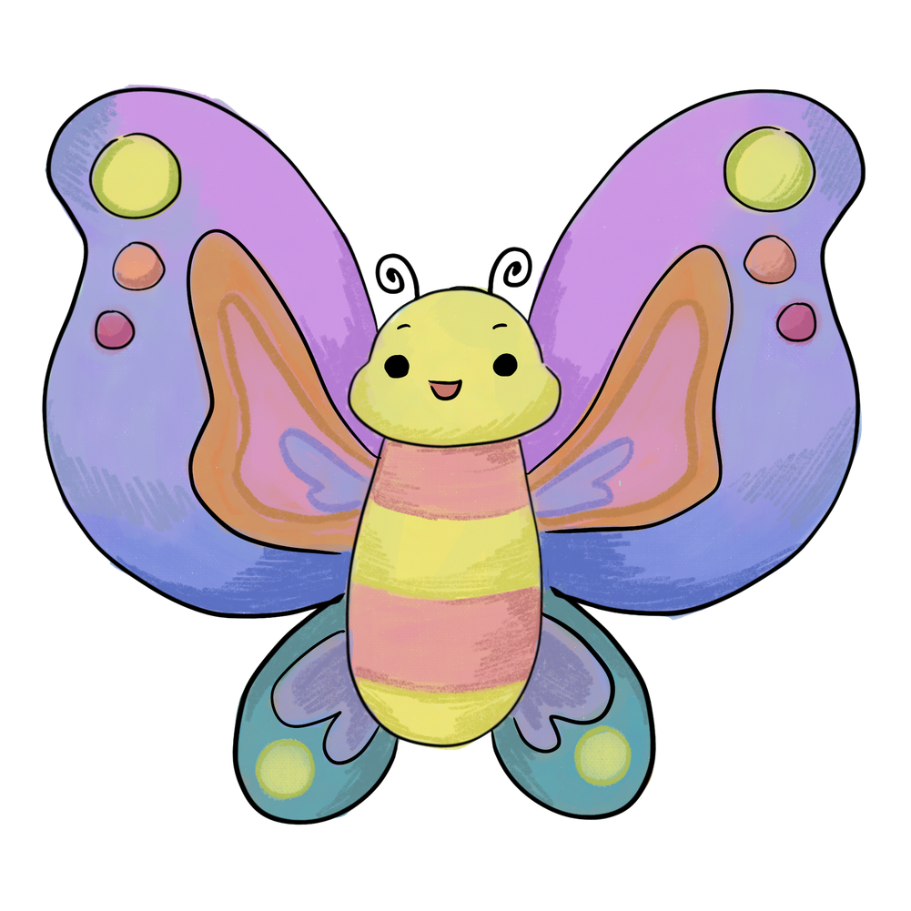
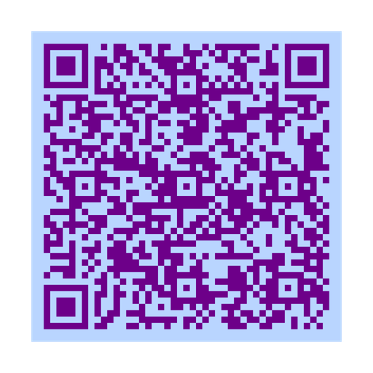
BOOK FUTURE
  Adapted for different age groups
    Focus on various conditions
  Feedback please!
  Attached lesson plan for classrooms
  DIY sensory space guide
  Audio book / online read-aloud
  Publish!
Art by Camila Gonzalez
Notes:
tallulah
prep interview talk
as cami explained, we're very close to completely finishing our book. in order to make sure
that our depiction of different diagnoses are realistic and thoughtful, we prioritize feedback from those with lived experiences when writing. We're waiting to conduct a couple more interviews with members of the neurodiverse community, and then we can go ahead and publish it! Next, i'm going to pass it on to oriana to talk about our sensory spaces. (to talk more about publishing, we now have haeley (maybe not though))

Slide 8
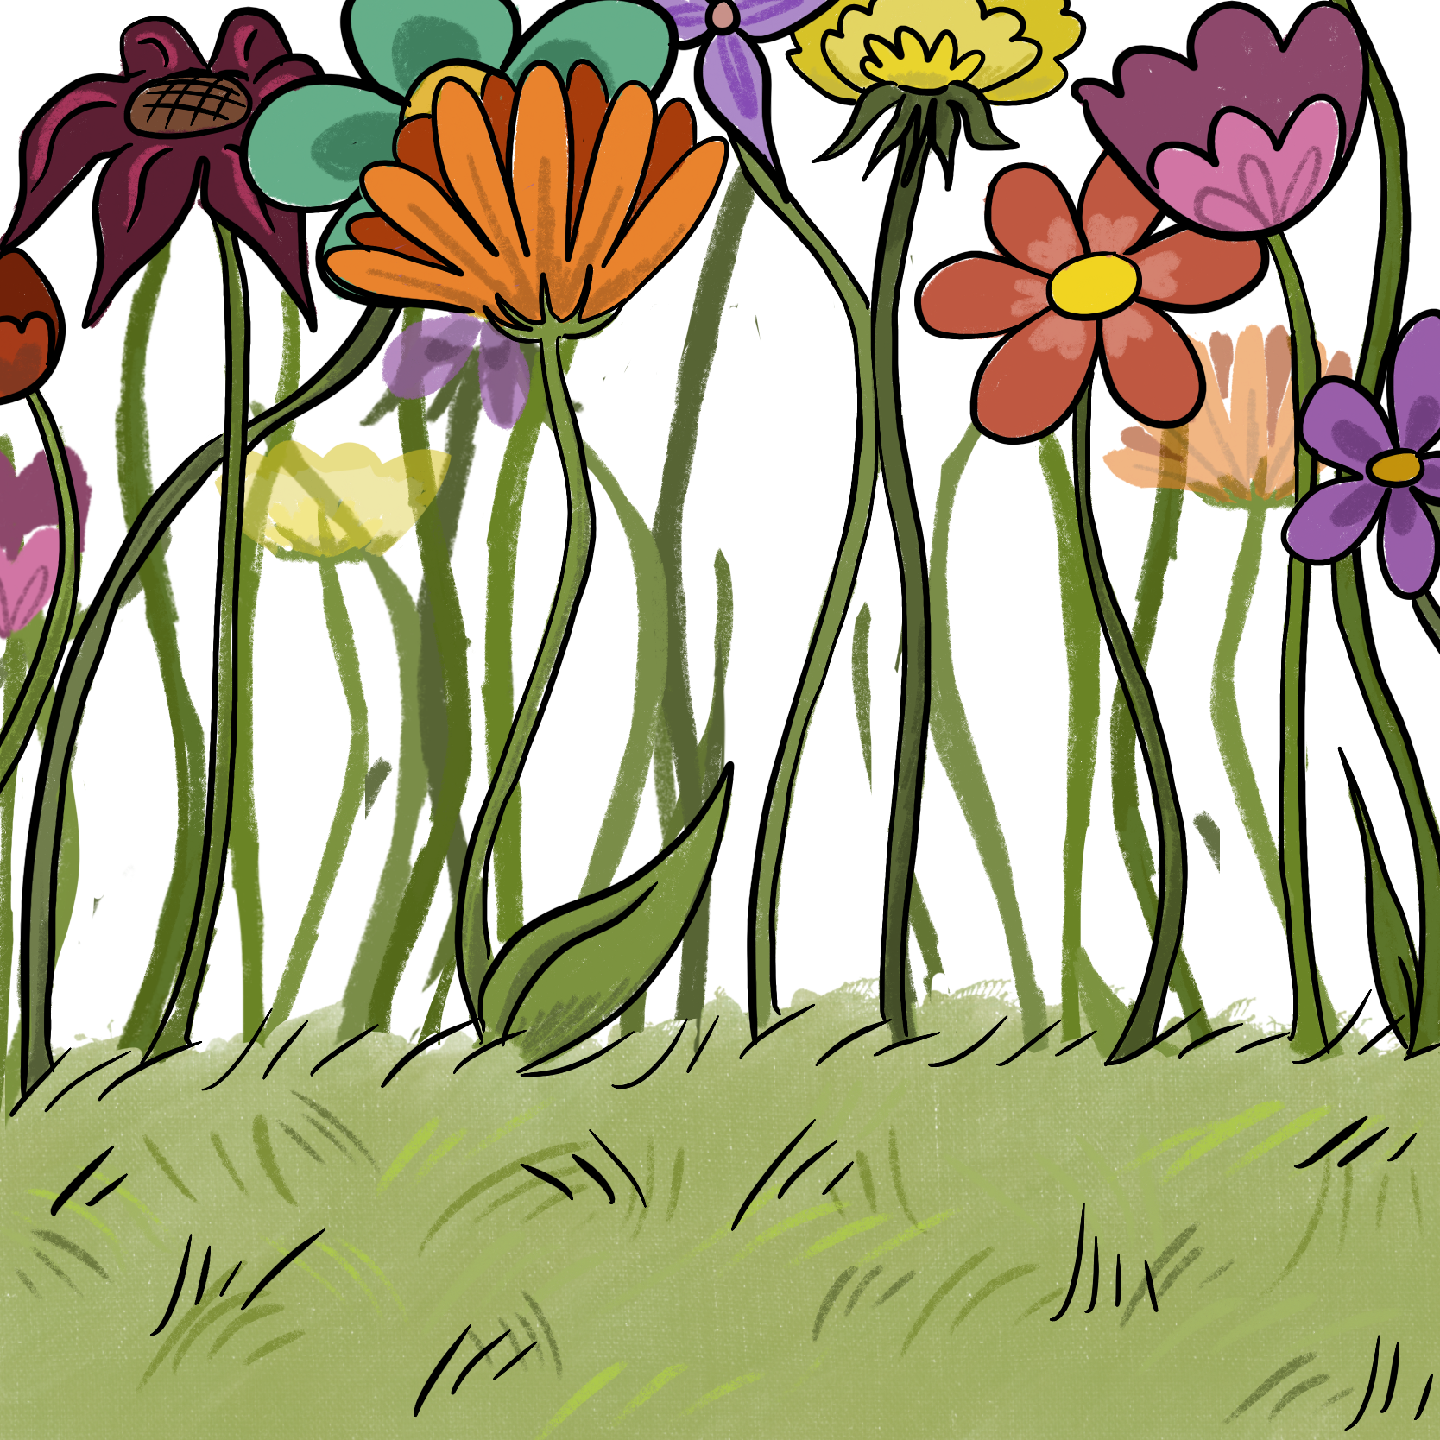
SENSORY SPACES
Cocoon Corners are unique storybook themed sensory places designed for children aged 5-12.
1) Spaces will include fidgets, storybooks, and educational pamplets
2) Promotes education, relaxation, and emotional regulation.
Notes:
Oriana
possible thing to say (cut from tallulah's slide):
after this initial, formal, introduction, we create a tangible center for neurodiversity so this new concept stays relevant in their lives. We call these centers "cocoon corners," just a corner of a given library, classroom, or other establishment we're working with. These corners act as a sensory retreat for overstimulated kids, specifically neurodivergent kids, with soft textiles, fidgets, and quiet. They're also a center for neurodiversity education, with pamphlets about neurodiversity and our book for kids to read on their own.

Slide 9
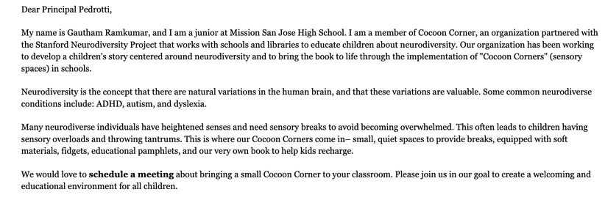
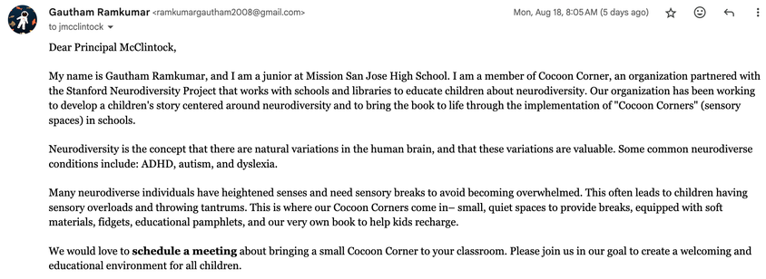
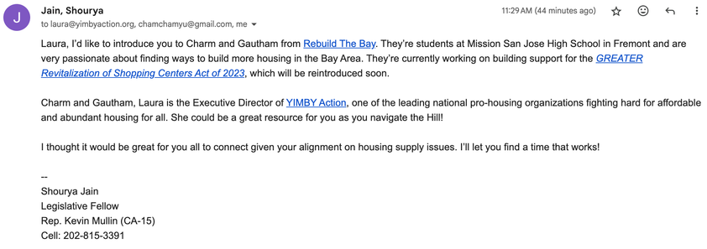
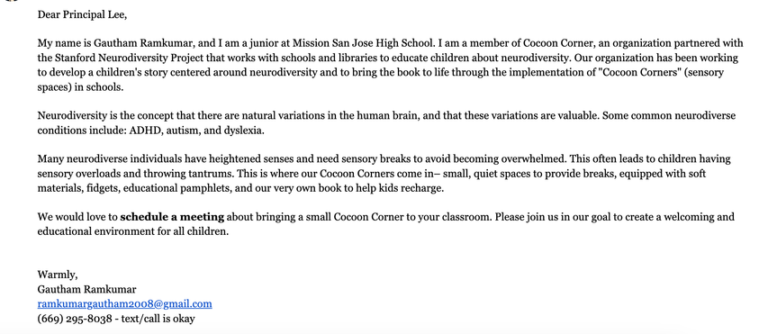
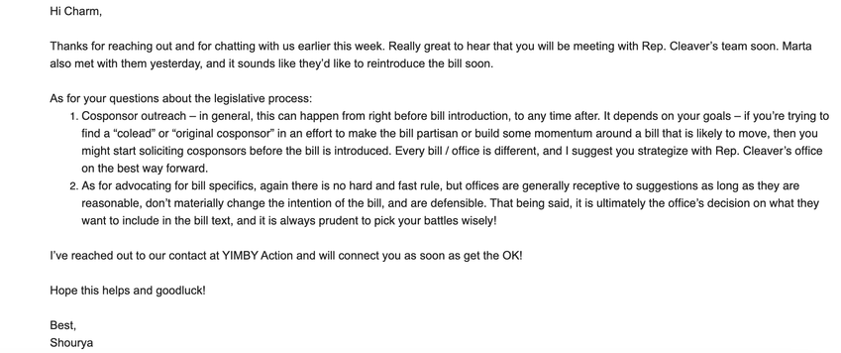
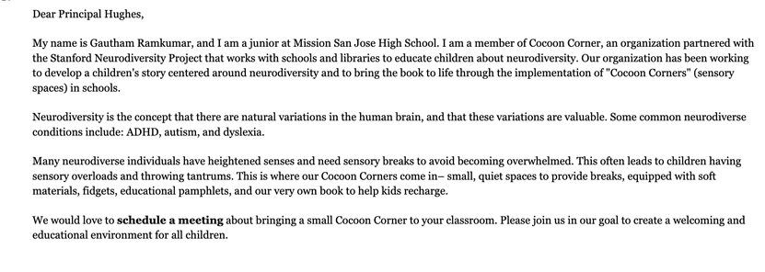

PROGRESS ON SENSORY SPACES
OUTREACH AND GROWTH FOR THE PROJECT HAS BEEN REMARKABLE
30+ Schools & Libraries Contacted
2 Potential New Projects
100+ more contacts coming

Slide 10
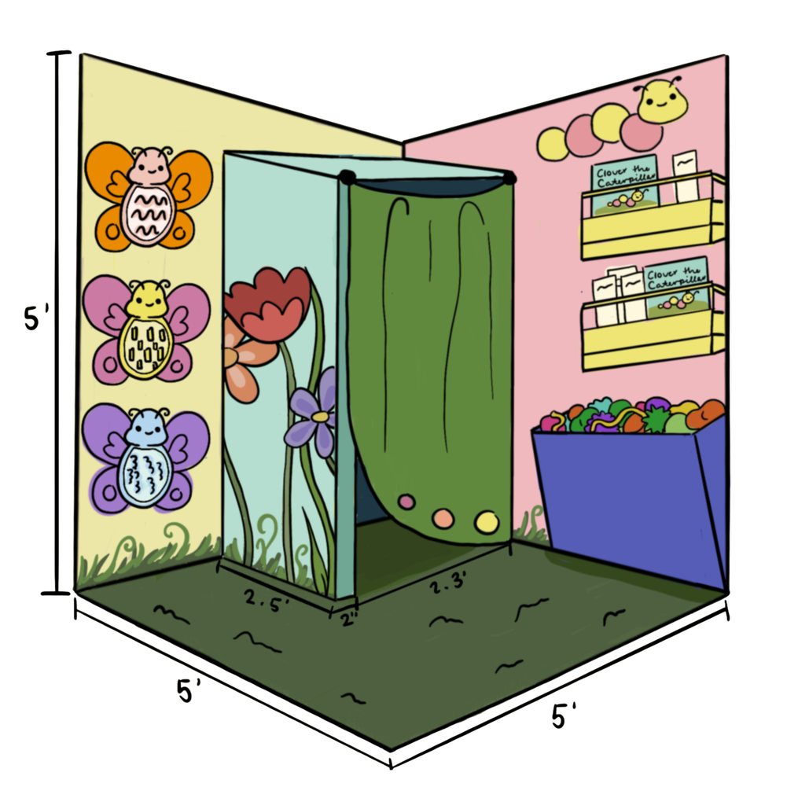
FUTURE PROGRESS
Sensory spaces everywhere.
Our goal is to implement five
sensory spaces by the
end of 2025.
Notes:
Gautham

Slide 11
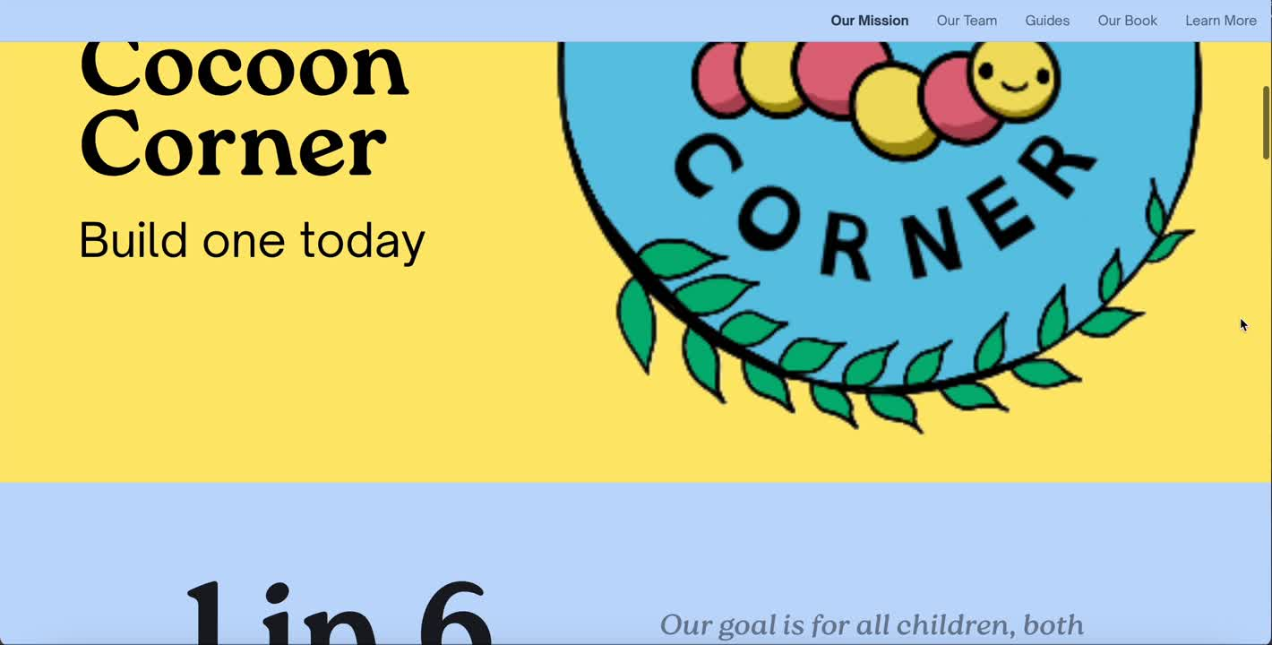
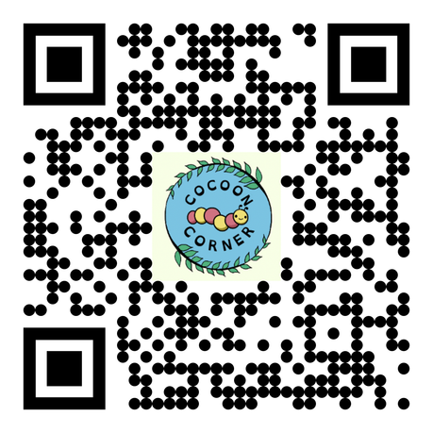
OUR WEBSITE
Notes:
cut? super cool, but not progress...

Slide 12
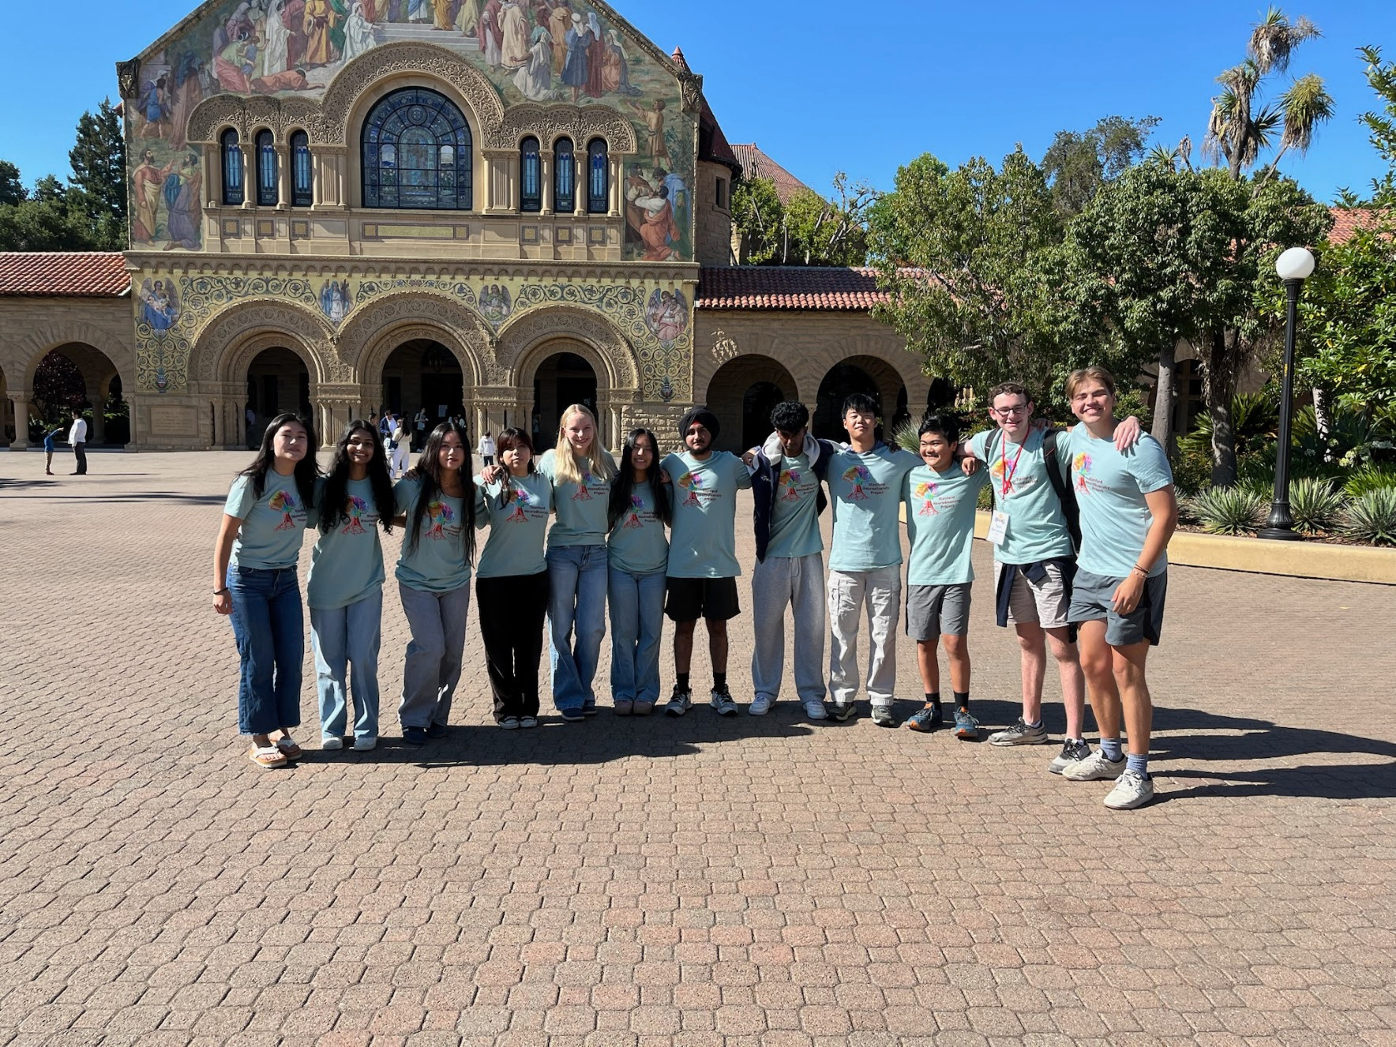
COCOON CORNER
SUMMARY
Notes:
tallulah
thank you for listening! we are cocoon corner, we're here with an innovative approach to help solve the neurodiversity education crisis, and we would love your support.

